Slide 1
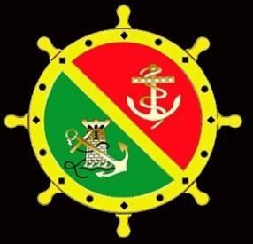
Irish Naval Association
This Powerpoint Presentation
is dedicated to our deceased members
Slides will appear automatically or click slide to move on
You have to click top of page “Slide Show”
then on left top click “from Beginning”
When first page appears Click Music Link below
www.irishnavalassociation.ie/muerte100.MP3
Minimise or drop down the music page so you can see the powerpoint presentation
The Music is
La Muerte No Es El Final
(Death is not forever)
Written by a Spanish Catholic Priest and adopted as a Hymn by the Spanish Military to pay tribute to those who died in Military Service
A little Opera is also added in between the beautiful Spanish Hymn

Slide 2
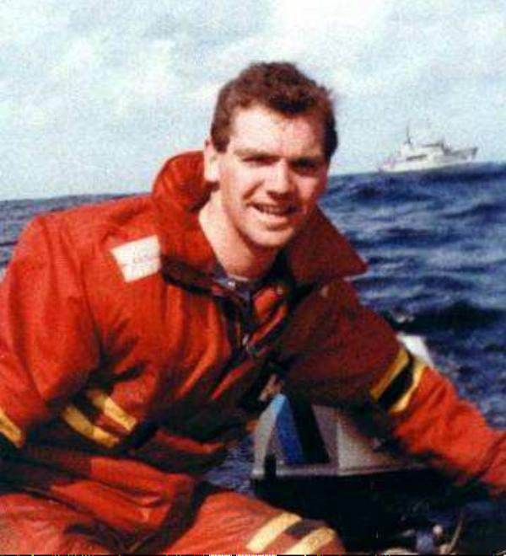
In 1994 the members of the Dublin Branch Irish Naval Association changed its name to "The Leading Seaman Michael Quinn DSM Branch" in honour of L/S Quinn and the tragic loss of his young life while attempting a rescue of Spanish Seamen from their stricken Spanish Trawler on rocks in terrible Sea conditions off Bantry Bay on the night of January30th 1990.
Leading Seaman Michael Quinn DSM

Slide 3
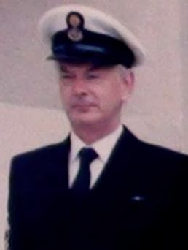
CPO Paul Daly N.S.
CPO Paul (Paud) Daly passed away on the 14th October 2020 and buried in his hometown in Naas Co Kildare.CPO Daly joined the Naval Service as a 17 Year Old in 1955, and completed 43 Years Service on reaching the retirement age of 60. For many Years prior to his retirement CPO Daly was part of the Cadre Staff in Cathal Brugha Barracks, Dublin with the responsibility of training and assisting the Naval Service Reserve (An Slua Muiri).
Following CPO Daly's retirement he joined the Naval Association and participated in many overseas trips and Cruises. Although the Corona Virus restrictions prevented his former colleagues from rendering the Military Honours befitting his standing in the Naval Service and Naval Association many of his colleagues attended the Mass and many more watched the Mass on Webcam.
CPO Daly will be missed by all his former colleagues and May he Rest in Peace

Slide 4
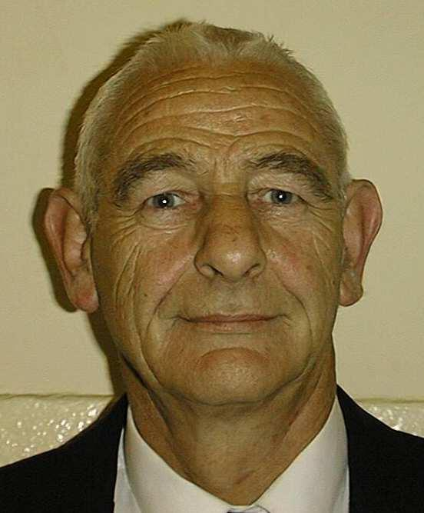
Brian served in the Naval Service in 50's and 60's amd joined the Naval Association in 1992. Brian travelled to the USA with his wife Marie on both our trips to the United States and many trips away including trips down the Shannon and Ship Cruises Unfortunately Brian had a fall down the Stairs at Home in mid 2019 suffering a serious Head Injury and following a long stay in Hospital passed away in February 2020 Brian was cremated and when time allows following the Corona Virus his ashes will be buried with his two young sons in Cobh Cemetery
Brian Keogh

Slide 5
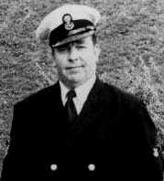
CPO Ollie Gowran
Ollie served for some years in the Naval Service after which he joined the Naval Reserve (An Slua Muiri) until Ollie had to retire on reaching the retirement age for a Chief Petty Officer 60 Years. When the Irish Naval Association was revamped in 1992 Ollie was one of the first to join.

Slide 6
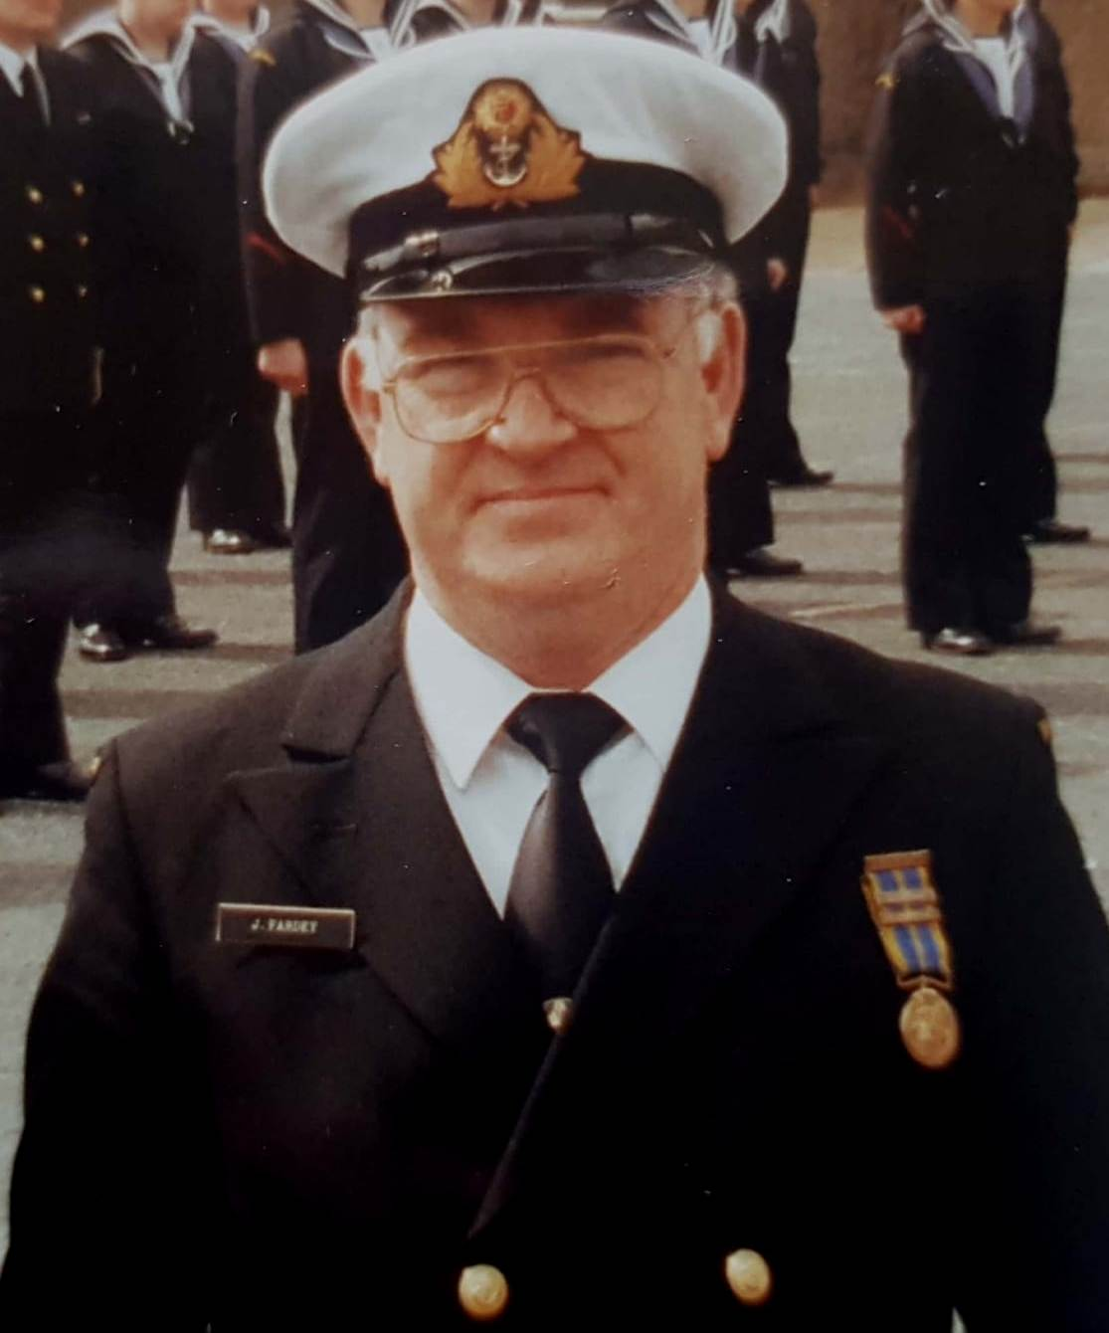
Lt.Cdr.Jim Fardey
Jim Fardey joined the Naval Reserve (An Slua Muiri) and rose through the ranks and was commissioned a Naval Reserve Officer in Waterford. Jim was eventually appointed the Commanding Officer and remained so until retiring on reaching the retirement age for a Lieutenent Commander. Jim then joined the Waterford Branch of the Irish Naval Association and remained in the INA until his death in 2017

Slide 7
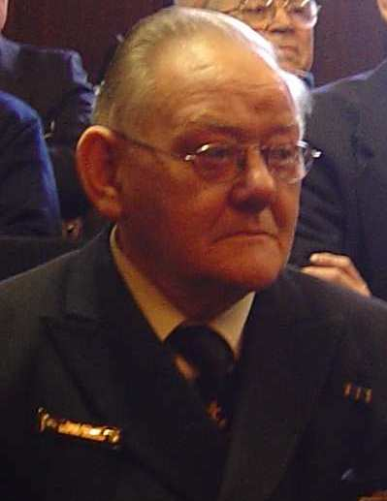
SCPO Noel O'Neill
Noel was a Senior Chief Petty Officer in the Limerick Branch of the Naval Reserve (An Slua Muiri) and remained until retiring on age grounds. Like many others Noel joined the Limerick Branch of the Irish Naval Association and remained a member until his death.

Slide 8
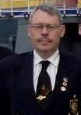
Raephael Clarke
Raephael was a member of the Naval Reserve (An Slua Muiri) for a number of Years. and was a member of the Dublin Branch of the Irish Naval Association until his untimely death

Slide 9
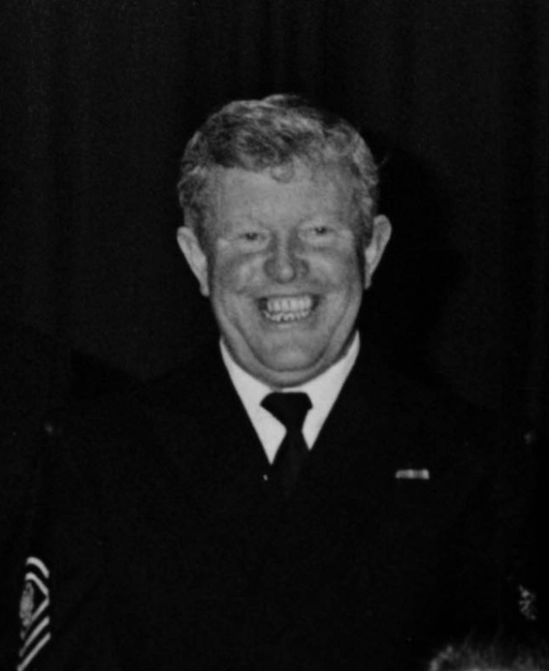
SCPO John Ruddy
Joined the Cork Branch of An Slua Muiri as a 17 year old and rising through the Ranks became the Senior Chief and remained so until retiring on age grounds. John then joined the Cork Branch of the Irish Naval Association and remained a member until his untimely death

Slide 10
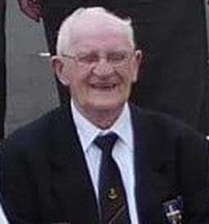
George Long
George was recognised in our Dublin Branch as one of the real genuine Gents and was very well liked by all who came in contact with George down the Years. George joined the Naval Service in the 50's and served for several Years.
When the Naval Association was revamped in 1992 George was one of the first to join, and never missed any organised overseas trips or local functions organised by the Naval Association.
It was a sad Day on the 1st of August 2018 when we learned of George’s Death and it was fitting that the Naval Association provided a 30 man Guard of Honour at his Funeral

Slide 11
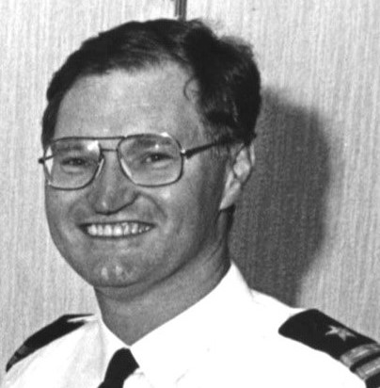
Lt.Cdr. Jim Corrigan
Jim was an Officer in the Irish Naval Reserve attaining the rank of Lt. Cdr and officer commanding the Limerick Branch of the Naval Service Reserve.
Jim was also an Engineering Officer with Irish Shipping.
Jim retired from the Naval Reserve on reaching retirement age now that time allowed Jim joined the Limerick Branch of the Irish Naval Association and was very active up to his untimely Death on the 2nd November 2017

Slide 12
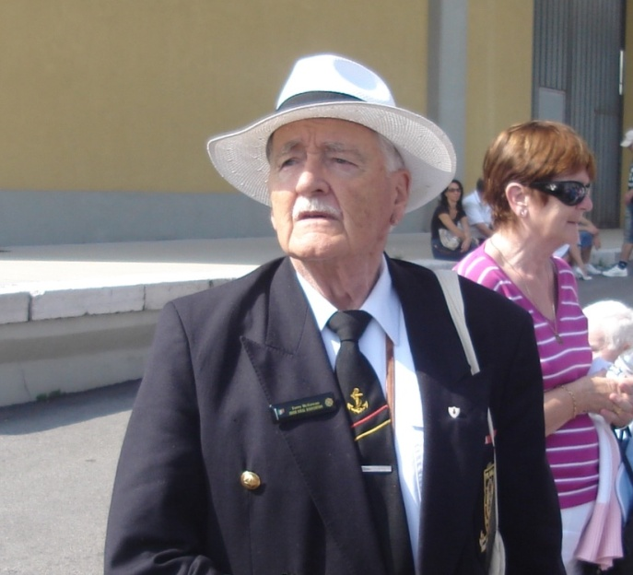
Terry McGowan
Terry was born in Southhampton in 1921 but raised in Dublin. In his earlier Years Terry was an Irish Army Officer and for some time attached to the Naval Base in Haulbowline, After Terry retired from the Army he worked for an American Airline Company and joined the Limerick Branch of the Irish Naval Association, and for two years was General Treasurer of the Irish Naval Association. Prior to his death Terry wrote his Book "Say' Do You Speak English" It really is a very interesting book and Terry recounts his School Days in Synge Street with Eamonn Andrews etc. Terry passed away on the 23rd September 2016

Slide 13
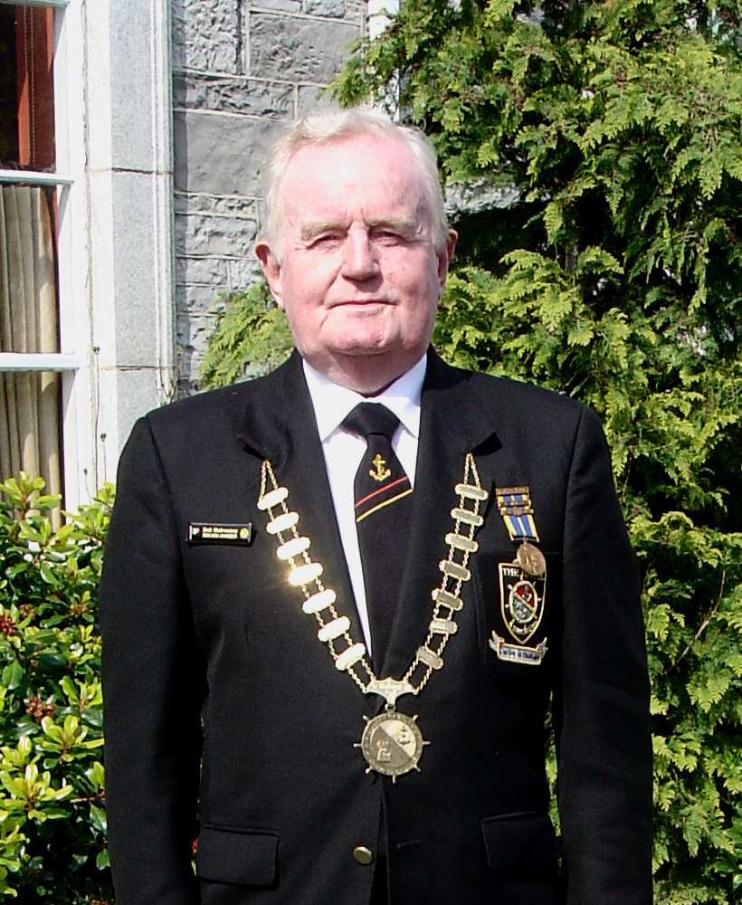
Lt. Cdr. Robert Mulrooney
Lt.Cdr Robert Mulrooney was a member of the Limerick Branch of the Naval Reserve (An Slua Muiri) and eventually rose through the ranks and became the Officer Commanding until his retirement
When the Irish Naval Association was revamped in 1992 Lt.Cdr. Mulrooney established a Branch in Limerick and during his
Years in the Irish Naval Association became its President and never missed any trips abroad and laid wreaths at many WW1 Graves in Belgium and France
Following a very short illness Robert passed away on Christmas Eve 2016

Slide 14
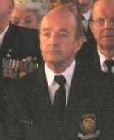
Pierce Power
Pierce was a Petty Officer attached to the Cadre Staff until reaching the age of retiring at 60 years of age, following 42 years in the Naval Service. Pierce has been a member of the Naval Association for many years. Pierce passed away suddenly at home in August 2016
His colleagues in the Dublin Branch of the Naval Association were Pall Bearers at the Funeral celebrated by Fr.Des Campion the Naval Chaplain and assisted by former NSR Lt. Jimmy Fennell now an ordained Deacon of the Catholic Church.

Slide 15
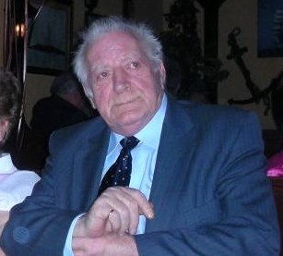
Paddy Watts
Paddy joined the Naval Service in the 1950's and was called "The Crow" by his Navy Colleagues because of his big head of Black Hair. Paddy joined the Naval Association in 1992 and travelled on many of our trips at home and abroad, particulary to the USA and France. Paddy had not been well for a long time and passed away in Hospital in February 2016

Slide 16
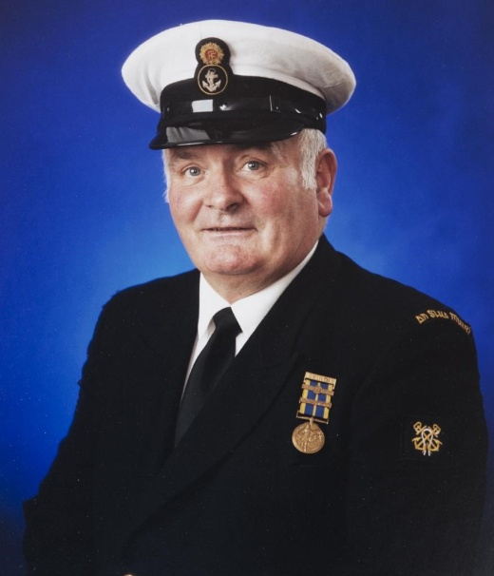
Frank Cassidy
Frank joined No2 Company An Slua Muiri in 1960 and went
on to achieve the Rank of Petty Officer.
Frank was a keen Sailor and was crew member on many trips at home and Abroad particulary on many weekend trips to the Isle of Man and to Holyhead in Wales Frank was also a great Cook and acted as our Chef on the Creidne Trips.
Frank joined the Naval Association in 1992 and travelled on many of our trips to the USA and France.
Frank had not been well and died in Hospital in 2015

Slide 17
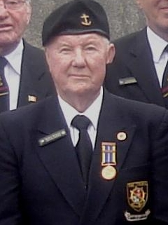
Herbert McManus
Joined An Slua in 1954 and served for many years. Herbert joined the Naval Association in 1998 and had never missed any trips until his sickness which eventually was his sad ending. He will be missed by all his colleagues

Slide 18
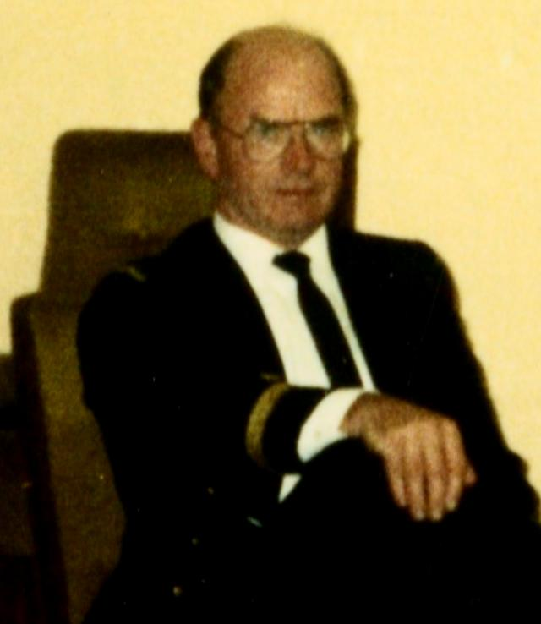
Lt. John Keohane
Joined An Slua Muiri (Naval Reserve) in 1960 and served for many years. He was commissioned as an Officer in 1975 and served until reaching retirement age.
On retirement John joined the Naval Association. It was unfortunate that ill health set in and he struggled on for a few years before passing away in October 2014

Slide 19
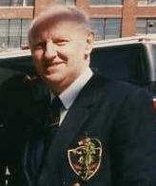
Lt. Cdr Gerry DeRenzy
Passed away on Saturday 25th January 2014. Lt.Cdr. DeRenzy Former Officer Commanding No 2 Coy. An Slua Muiri (Naval Service Reserve) until his retirement in 1986. A life long member of the Irish Naval Association he will be sadly missed by all his former colleagues in the Navy and the Naval Association. Gerry was also a very successful business man running his own business for many years. A keen Golfer and a member of the Bohemians musical society and guest performer regularly singing with his fine Baritone singing voice,

Slide 20
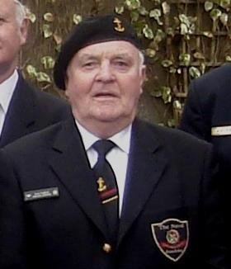
Jack English
Joined the Naval Service in the 50's and served for many years. Jack joined the Naval Association in 1994 and has travelled on many trips at home and abroad Jack was a great singer and always gave a song when asked. It was while he was with us in Coventry in June 2014 at the Royal Naval Conference that he collapsed and died of a heart attack.

Slide 21
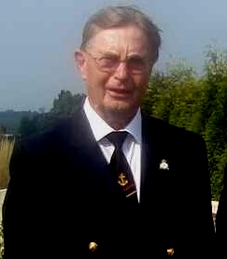
Roy Skinner
An Associate Member of the Waterford Branch was in his 90's when he died. Roy was a Pilot in the RAF during the war and when he retired moved to Waterford and joined our Association.

Slide 22
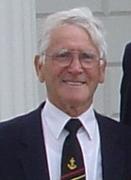
Paddy Farren
Paddy was a member of the Naval Service for many years in the 50's 60's and joined the Naval Association in 1992 and was an active member participating in nearly all trips abroad and all functions at home until his death in February 2013

Slide 23
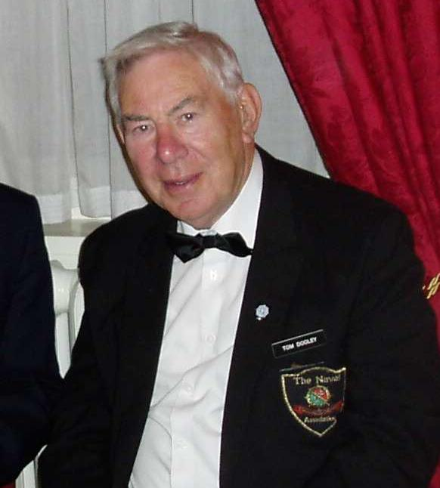
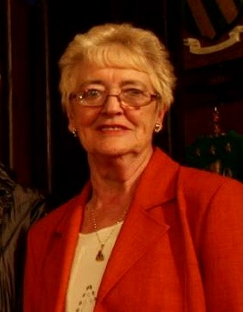
Tom and Breda Dooley
Tom joined the Marine Service in 1943 subsequently renamed the Naval Service in 1946. Tom joined the Naval Association in 1992 and was a very active participant in all its functions and trips abroad. Tom was ill on and off for several months and despite great Hospital care Tom passed away on September 7th 2012 and was rendered Naval Association Honours by all his colleagues in the Naval Association.
Tom's wife Breda continued to be an active Associate member of the Naval Association in Dublin and continued as a member of the social committee until Breda's death in January 2018.

Slide 24
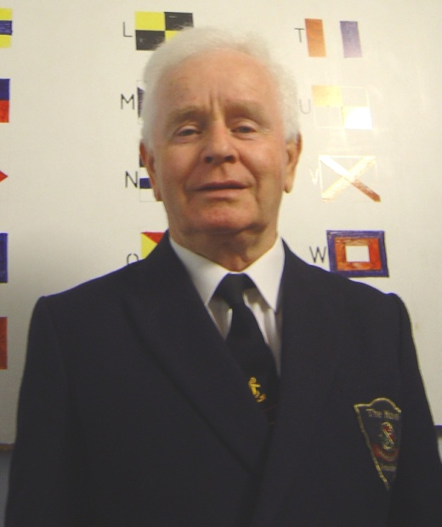
Sean Meleady
Sean spent a few years as a member of No 2 Coy An Slua Muiri in the 70's and 80's. Sean joined the Naval Association in 1997 and participated in all function and trips abroad. In 2008 Sean underwent treatment and surgery for Cancer which prevented him from participating in our first Cruise abroad, however, although he was still recovering from further treatment in 2009 he went came on our Mediterranean Cruise out of Venice.
Although Sean seemed to be recovering from his Cancer it unfortunately came back and Sean passed away peacefully on the 6th April 2010. Sean is buried in Esker Cemetery Lucan close to our colleagues Tom Dooley and Piaras O'Connor

Slide 25
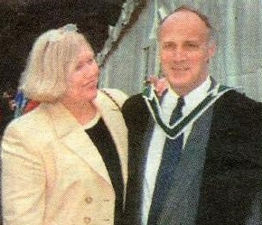
SCPO Peter King
Peter was to retire in February 2004 after 44 years service, was tragically killed in a car crash while travelling through Liverpool on Wednesday 8th October 2003. Dymphna his wife for 35 years also lost her life. They had visited the UK to be with their daughter Tara to celebrate the 1st birthday of one of Peter and Dymphna's grandchildren. Sadly two more in the car with Peter and Dymphna also lost their lives, Their daughter Tara's mother-in-law Mrs Barbara George and her mother-in-laws sister (Mrs. Stella Murphy) died in the car accident. The car was driven by Stella Murphy's Husband. He miracously survived this terrible tragedy. In keeping with tradition Peter was rendered full Naval Honours. All sections of the Defence Forces were represented. A Piper from the Irish Air Force led the cortege along the route to the grave

Slide 26
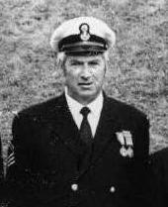
SCPO Dick Larkin
Dick joined the Maritime Inscription in 1943 which subsequently was renamed An Slua Muiri in 1947 and rose through the ranks to Senior Chief Petty Officer and retired on reaching the retirement age for his rank in 1986. Dick as he was known to his friends will always be remembered for his catch phrase "Hello There".
Dick was to travel to Boston in 1996 with the Naval Association to participate in the Boston St. Patrick's Day Parade celebrating the 50th anniversary of the establishment of the Naval Service in 1946 (formerly The Marine Service). However Dick got sick some weeks before we were to travel and passed away on Wednesday 13th March 1996 two days short of his 70th Birthday.

Slide 27
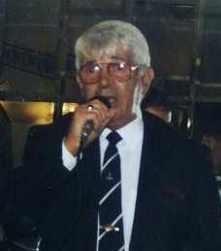
Audie Devlin
Audie was former Lt. in No 2 Coy An Slua Muiri joined the Naval Association in 1992. Travelled overseas to participate in the Boston St. Patrick's Day Parade in 1996 and again to San Diego in 1998. Excellent on the Guitar and many will remember Audie singing "Jessie James" and "Maggie May" Audie died around 2007/2008

Slide 28
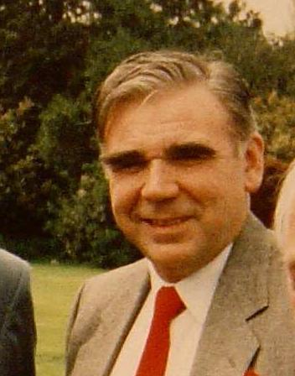
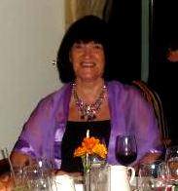
Christy King (Died 1998)and Wife Patsy (Died Feb 2018)
Christy joined An Slua Muiri in March 1958 and left in the mid seventies. Christy joined the Naval Association in 1992 and was one of the Banner bearers heading our group of 185 in the Boston St.Patrick's Day Parade.
While working as Foreman in Dakota Printing works in September 1998 Christy collapsed and died of a heart attack. Christy is buried first turn left inside the gates of Mount Jerome Cemetery, Christy's grave is about 10 graves down on the left.
, Christy's Wife Patsy remained an Associate Member after Christy's Death and Patsy and her two sisters Anne and Babs still travelled with us on our Trips at home and abroad. Patsy died in February 2018 after a short illness and buried with Christy in Mount Jerome Cemetery

Slide 29
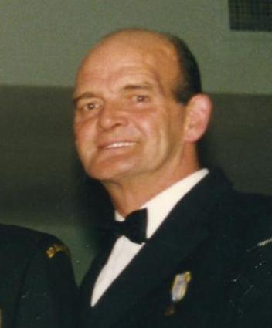
CPO Shay McCarthy
Joined An Slua Muiri in 1955 and served 43 years before retiring on age grounds in November 1998. Shay was an excellent Mechanic and anyone who skippered the sail training vessel STY Creidne would be very happy to have Shay as their ERA on the many trips coastal and overseas. Many a night in bad weather with a problem engine Shay would be down in the smelly bilge fixing the engine when both engine and sail was needed. Shay was a lovely singer and many times we listened as he sang "Anna Marie". Shay died in St. James Hospital on march 12th 2005. Following Naval Association rendering Naval Honours at his funeral Shay was cremated. A few days later a Naval Reserve launch under Lt.Sean Earley NSR brought Shay's Family out off Dun Laoghaire to scatter Shay's ashes in the area Shay enjoyed many years training and sailing as a member of An Slua Muiri. It was a sad moment as Shays two Daughters Sharon and Debbie and Son Seamus Jnr. scattered the ashes off the Launch as P/O John O'Neill piped from the After Deck
Sadly Shay's son Seamus Jnr. Passed away from a Brain Tumor at a relatively young age.

Slide 30
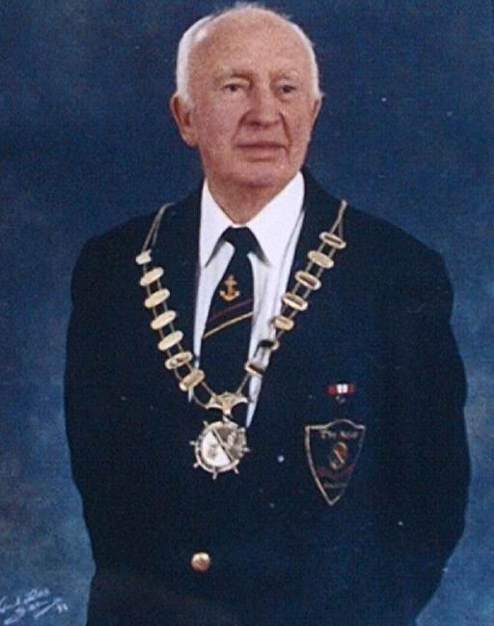
Piaras O'Connor
Naval Asssociation (President 1994-1998) Joined the Marine Service in 1940 where he became an Engine Room Artificer, he served on the Mine Planting Vessel, Shark. Piaras was both boxing and physical training instructor in the service. He served until 1948. A brother of Piaras's was one of the officers who took over Beggar's Bush Barracks in 1922 and later was C. O. of Cathal Brugha Barracks, Colonel Padraig O'Connor's name is listed on the board in the Officers Mess.
Piaras at 84 years made a decision that he would undergo a necessary life saving heart operation and following a triple byepass enjoyed 2 more years of good health. Unfortunately Piaras had a slight stroke and developed other health problems and subsequently died on St Patricks day 2004. Piaras was 86 and was rendered full Naval Honours at Esker Cemetery.

Slide 31
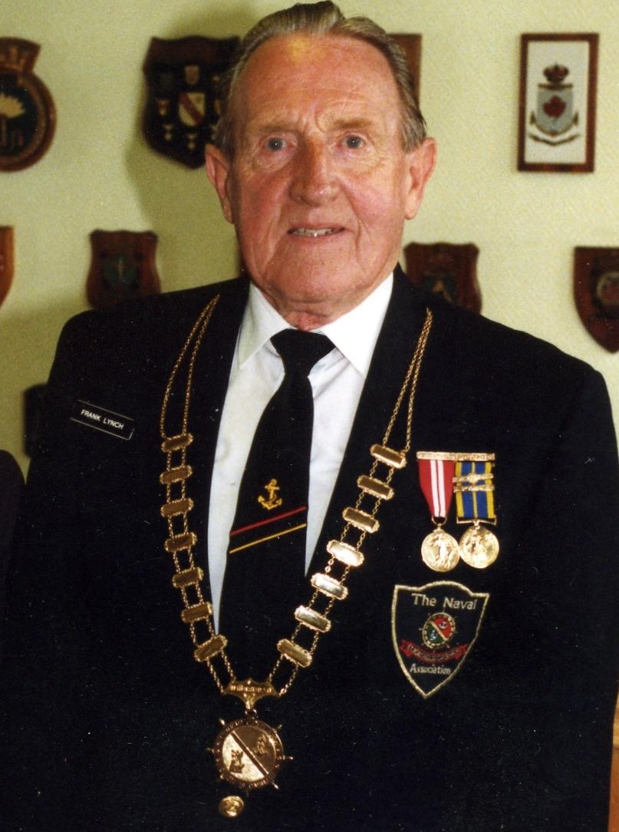
Lt.Cdr.Frank Lynch
Naval Association President 1992-1994 Joined the Maritime Inscription in 1943, and was posted to Dublin Port Control.The name changed to An Slua Muiri in 1946, and Frank was commissioned to officer rank in 1955. Frank was a great rifleman and won the overall best individual shot on many an occasion. He took command of No. 2 Coy, An Slua Muiri in 1969 where he achieved the highest rank which can be attained in An Slua Muiri, Lt. Cdr., he stood down in 1983 with 40 years voluntary service. Outside of An Slua Muiri, Frank was a keen soccer player and referee. He probably gave as many years to football as he did to An Slua Muiri (now renamed Naval Service Reserve). Frank fell ill and died in 2005. Frank was rendered full Naval Honours by the Naval Association

Slide 32
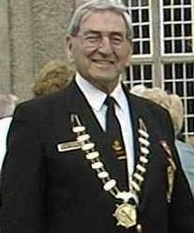
Ray Murphy
Naval Association President 1998-2000 Joined the Marine service in 1941 and served on the Motor Torpedo Boats as anEngine Room Artificer until 1945. Ray was a great swimmer as a young man and won many trophies while in the service. Ray spent most of his civilian life with Aer Lingus and did a lot of overseas contract work. Ray and his wife Monica are great singers and are pillars of the R. & R Musical Society.
Ray passed away suddenly on Tuesday 26th November 2001 in the manner in which he lived, peacefully and gently. May he Rest in Peace. At his Cremation he was rendered full honours.
It was the families wish that Ray's ashes would be scattered off Roche's Point in Cork Harbour. 88 members of the Naval Association travelled to Cork to participate in this moving ceremony. Our Chaplain Fr.Des campion assisted at the ceremony.

Slide 33
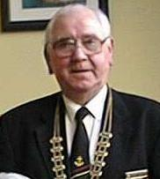
Mick Philbin
Naval Association President 2001-2002 Joined the Marine Service 1946, which became the Naval Service later that year.Michael served on the Motor Torpedo Boats, and the Corvettes, and was for many years a physical instructor in the service, he left the service in 1952 with the rank of Leading Seaman. After his period in the service, Michael went into commercial banking where he remained until his retirement.
In July 2002 while driving on a remote country road in his native county of Westport in the west of Ireland, Michael suffered a heart attack and his car left the road and overturned into a ditch. Unfortunately Michael was dead before anyone had an opportunity to render any assistance. Michael was rendered full Naval Honours in Dublin before his cremation in Dublin. As was his wish his ashes were scattered into the sea off Westport

Slide 34
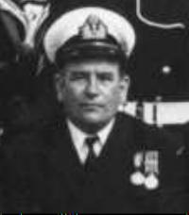
Lt. Peter Marrey
Peter joined An Slua Muiri in 1950 and rose through the Ranks to Lieutenant and retired on age grounds in 1989.
Peter joined the Naval Association in 1995 and participated in several of our trip abroad.While we did attend peter's Funeral we are not sure of the year peter died. We will correct this in due course.

Slide 35
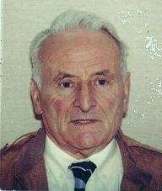
Tom Doherty
Tom like many of his colleagues in the Naval Association, joined the Marine Service in 1943 and continued in the Naval service for many years.Tom and his wife suffered the tragic double death of their daughter and granddaughter and it had a terrible lasting effect on their lives. Tom passed away in 2009

Slide 36
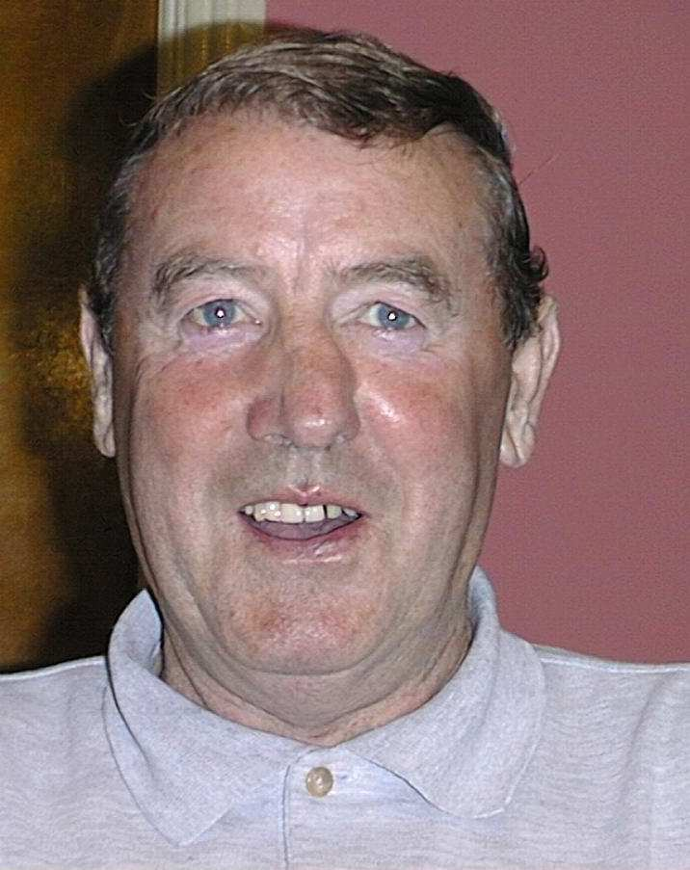
Paddy Redmond
Paddy was a former member of the Naval Service. He joined the Naval Association in 1998 and remained a member until his death in March 2009

Slide 37
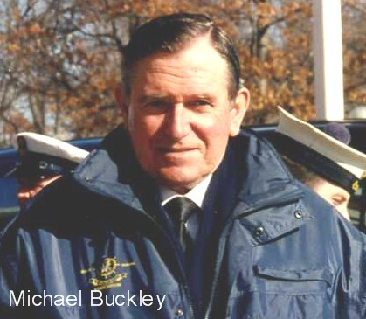
Michael Buckley
Michael served in the communications branch of the Naval Service in the 60' 70's. Michael joined the Naval Association when the Association was revamped in 1992 and served as Treasurer. Michael was very active and participated in many trips abroad including the Boston St. Patrick's Day Parade and trips to the WW1 battle sites.

Slide 38
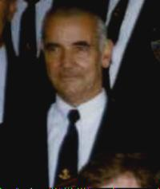
Jimmy Lamberd
Jimmy served in the Naval Service in 50's.
Jimmy joined the Naval Association in 1992 and travelled to the USA on both our
trips to the States

Slide 39
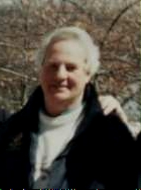
Peadar Somers
Peadar served in the Marine Service and the Naval Service in 40's and 50's. Peadar joined the Naval Association in 1992, and participated in all our trips up to his last trip in March 1998 when he and wife Angela travelled with us to San Diego. However, Peadar was not well in San Diego and spent most of the week in bed in the Hotel. Peadar was ill for the next few months and passed away in August 1998 Peadar always had a love for the Sea and after his service in the Naval Service joined Irish Shipping. It was his wish that his ashes be scattered at Sea...

Slide 40
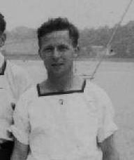
P/O Frank Wynne
Joined An Slua Muiri (Naval Reserve) in 1954 rising through the ranks to Petty Officer. Frank joined the Naval Association in 1992 and although not certain of actuall date he passed away we believe it was 2009

Slide 41
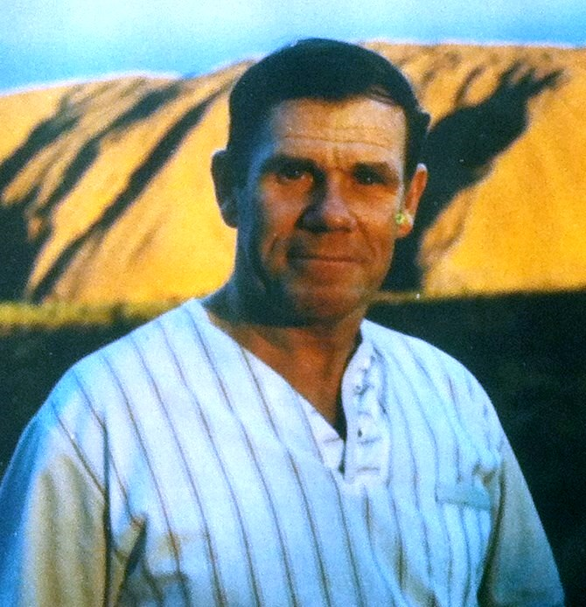
Liam Clarke
Joined the Naval Service in 1962 and for a number of years was on the Cadre Staff attached to Cathal Brugha Barracks Dublin until his death while still in service on the 29th November 2000. Liam was a member of the Naval Association and one high light of his membership was his first sking trip with the Naval Association in 1999
He is sadly missed by all his colleagues in the Naval Service and the Naval Association.

Slide 42
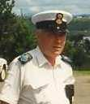
SCPO Seamus Dalton
Seamus was a member of No 3 Company An Slua Muiri in Waterford and was Senior Chief Petty Officer. Seamus joined the Irish Naval Association but took ill and passed away in his first year in the INA.

Slide 43
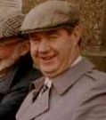
Paddy Dunphy
Paddy served as a Petty Officer in the Naval Reserve No 3 Company waterford An Slua Muiri. When the Irish Naval Association was established in 1994 Paddy was one of the first to join.

Slide 44
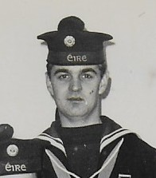
Fred Penkert
Fred was a member of the Waterford Branch of An Slua Muiri. Fred was an excellent shot and a member of the winning team during the Annual Shoot in Clonmel.
Due to work commitments Fred left An Slua Muiri after a period of service.
When the Irish Naval Association was established in Waterford in 1994 Fred was one of the first to join and was the Branch's first secretary. After about two years while working late in his job Fred suffered a massive Heart Attack and did not recover. All Freds colleagues admit Fred was great company to be with, and is sadly missed by all his colleagues

Slide 45
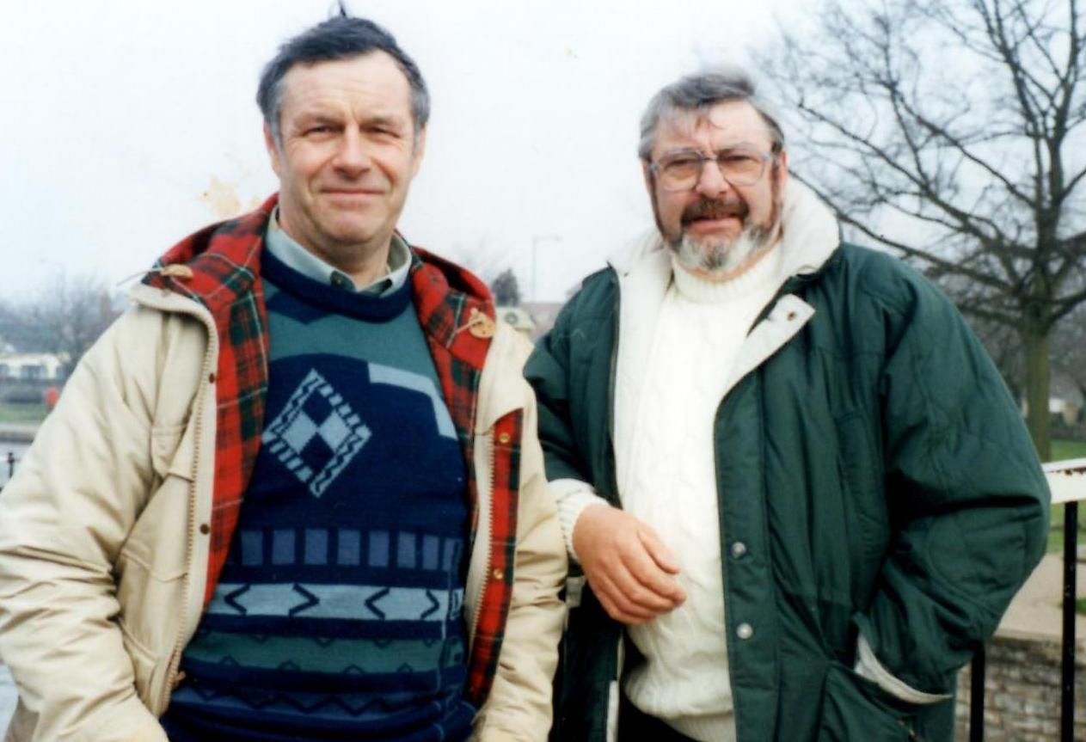
Michael & Sean O’Flynn
Brothers Michael and Sean O’Flynn both were members of the Limerick Branch of An Slua Muiri (Naval Service Reserve) in the 1960’s.
Sean joined An Slua Muiri from 1964 to 1969 and subsequently went to work in the UK and died on 30th June 2012.
Michael having served in An Slua Muiri joined the Irish Naval Association
In 1996 but following a short illness passed away on the 4th April 2000
(End of Slide Show Click Page to end)

