Slide 1
.
This PowerPoint presentation is dedicated to all our friends and colleagues who have passed on. We would like to remember them as the great friends they were.
As that saying goes, “at the going down of the Sun we will remember them”
To Play this slide show
1... click “Slide Show” at the top bar above
2... On the far left click “from the beginning” to start presentation slideshow.
3.. When slideshow starts click space bar or return button to move to next slide
In the following presentation you will see names that you may not be familiar with . Here is a brief description
1. The Maritime Inscription (Naval Reservists) from 1941 to 1947 then renamed An Slua Muiri. In 2000 An Slua Muiri was renamed the Naval Service Reserve (NSR) 2. The Marine Service was established at the out break of the second world war and subsequently renamed the Naval service in 1946.

Slide 2
Lt. Cdr. Robert Mulrooney, Retired Officer Commanding the Naval Service Reserve in Limerick and President and founder member of the Limerick Branch of the Irish Naval Association December 2016

Slide 3
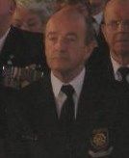
Pierce Power
Pierce was a Petty Officer attached to the Cadre Staff at Cathal Brugha Barracks in Dublin until reaching the age of retiring at 60 years of age, following 42 years in the Naval Service.
Pierce had been a member of the Naval Association for many years. Pierce passed away suddenly at home in August 2016
His colleagues in the Dublin Branch of the Naval Association were Pall Bearers at the Funeral celebrated by Fr.Des Campion the Naval Chaplain and assisted by former NSR Lt. Jimmy Fennell now an ordained Deacon of the Catholic Church.

Slide 4
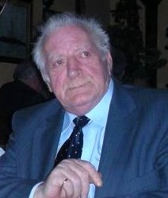
Paddy Watts
Served in The Naval Service during the 1950’s.
Paddy joined the Naval Association on its revamping in 1992 and travelled with the Naval Association in many trips abroad to the USA and France.
Paddy passed away after a short illness in February 2016

Slide 5
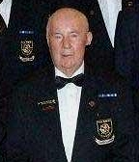
Herbert McManus
Served in An Slua Muiri during the 1960’s.
Herbert joined the Naval Association in 2002
and travelled on many trips overseas.
Herbert passed away after a short illness in 2014

Slide 6
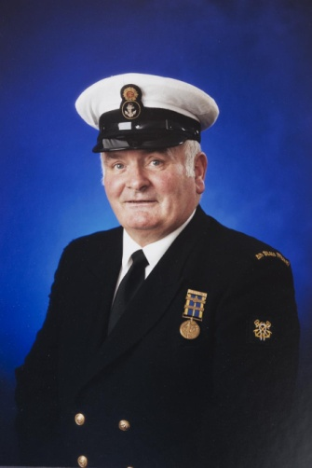
Frank Cassidy
Served in An Slua Muiri for 40 years up to his
retirement age attaining the rank of Petty Officer
Frank Joined the naval Association when it was revamped in 1992 and died after a long illness in 2014

Slide 7
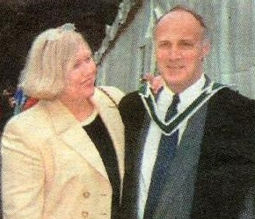
.
Senior Chief Petty Officer, (Irish Naval Service Reserve) was to retire in February 2004 after 44 years service, was tragically killed in a car crash while travelling through Liverpool on Wednesday 8th October 2003. Dymphna his wife for 35 years also lost her life. They had visited the UK to be with their daughter Tara to celebrate the 1st birthday of one of Peter and Dymphna's grandchildren. Sadly two more in the car with Peter and Dymphna also lost their lives, Their daughter Tara's mother-in-law Mrs Barbara George and her mother-in-laws sister (Mrs. Stella Murphy) died in the car accident. The car was driven by Stella Murphy's Husband. He miracously survived this terrible tragedy.
In keeping with tradition Peter was rendered full Naval Honours. This to the best of our knowledge is the first time such honours were rendered to both a husband and wife and we pray to God it will not be necessary again. All sections of the Defence Forces were represented. A Piper from the Irish Air Force led the cortège along the route to the grave. Lined up on each side was senior Officers, N.C.O's and Ratings from the Naval Service, Naval Service Reserve, Irish Army, Army Reserve, Irish Naval Association, and Organisation of National ex-service men and Women and many other organisations who were present to support Peter's and Dymphna's extended families
See Peter and Dymhna's last journey to their resting place, Click ..Here ..

Slide 8
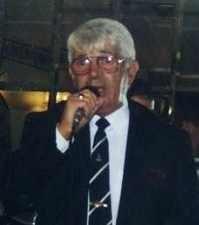
Audie Devlin
.
Audie a former Lt. No 2 Coy An Slua Muiri joined the Naval Association in 1992. Travelled overseas to participate in the Boston St. Patrick's Day Parade in 1996 and again to San Diego in 1998. Excellent on the Guitar and many will remember Audie singing "Jessie James" and "Maggie May"
Audie died around 2007/2008

Slide 9
Christy joined An Slua Muiri in March 1958 and left in the mid seventies. Christy joined the Naval Association in 1992 and was one of the Banner bearers heading our group of 185 in the Boston St.Patrick's Day Parade. While working as Foreman in Dakota Printing works in September 1998 Christy collapsed and died of a heart attack. Christy is buried first turn left inside the gates of Mount Jerome Cemetery, Christy's grave is about 10 graves down on the left.
Christy King

Slide 10
Tom Doherty Tom like many of his colleagues in the Naval Association, joined the marine Service in 1943 and continued in the Naval service for many years. Tom and his wife suffered the terrible tragic death of their daughter and granddaughter and it had a lasting effect on their lives. Tom passed away in 2009

Slide 11
Frank Wynne Joined An Slua Muiri (Naval Reserve) in 1954 rising through the ranks to Petty Officer. Frank joined the Naval Association in 1992 and although we are not certain of the actual date Frank passed away we believe it was 2009

Slide 12
Jimmy Lamberd Jimmy served in the Naval Service in 50's. Jimmy joined the Naval Association in 1992 and travelled to the USA on both our trips to the States .

Slide 13
Peter Marrey Peter joined An Slua Muiri in 1950 and rose through the Ranks to Lieutenant and retired on age grounds in 1989. Peter joined the Naval Association in 1995 and participated in several of our trip abroad. While we did attend Peter's Funeral we are not sure of the year peter died. We will correct this in due course.

Slide 14
Paddy Farren Paddy was a member of the Naval Service for many years in the 50's 60's and joined the Naval Association in 1992 and was an active member. Paddy participated in nearly all trips abroad and all functions at home until his death in February 2013

Slide 15
Tom Dooley
Tom Dooley joined the Marine Service in 1943 subsequently renamed the Naval Service in 1946. Tom joined the Naval Association in 1992 and was a very active participant in all its functions and trips abroad. Tom was ill on and off for several months and despite great Hospital care Tom passed away on September 7th 2012 and was rendered Naval Association Honours by all his colleagues in the Naval Association. Tom's wife Breda continues to be an active Associate member of the Naval Association in Dublin and also continues as a member of the social committee. I am sure this would be Toms wish.

Slide 16
Paddy Redmond Paddy was a former member of the Naval Service. He joined the Naval Association in 1998 and remained a member until his death in March 2009

Slide 17
Peadar served in the Marine Service and the Naval Service in 40's and 50's. Peadar joined the Naval Association in 1992, and participated in all our trips up to his last trip in March 1998 when he and wife Angela travelled with us to San Diego. However, Peadar was not well in San Diego and spent most of the week in bed in the Hotel. Peadar was ill for the next few months and passed away in August 1998 Peadar always had a love for the Sea and after his service in the Naval Service joined Irish Shipping. It was his wish that his ashes be scattered at sea
Peadar Somers
See Angela scatters Peadar's Ashes at Sea

Slide 18
Sean Meleady Sean spent a few years as a member of No 2 Coy An Slua Muiri in the 70's and 80's. Sean joined the Naval Association in 1997 and participated in all functions and trips abroad. In 2008 Sean underwent treatment and surgery for Cancer which prevented him from participating in our first Cruise abroad, however, although he was still recovering from further treatment in 2009 he went on our Mediterranean Cruise out of Venice. Although Sean seemed to be recovering from his Cancer it unfortunately came back and Sean passed away peacefully on the 6th April 2010. Sean is buried in Esker Cemetery, Lucan, Co Dublin close to our colleagues Tom Dooley and Piaras O'Connor

Slide 19
Michael Philbin (President 2001-2002) In July 2002 while driving on a remote country road in his native county of Westport in the west of Ireland, Michael suffered a heart attack and his car left the road and overturned into a ditch. Unfortunately Michael was dead before anyone had an opportunity to render any assistance. Michael was given full Naval Honours in Dublin before his cremation. As was his wish his ashes were scattered into the sea off Westport See Micks profile

Slide 20
Frank Lynch (President 1992-1994) Joined the Maritime Inscription in 1943, and was posted to Dublin Port Control. The name changed to An Slua Muiri in 1946, and Frank was commissioned to officer rank in 1955. Frank was a great rifleman and won the overall best individual shot on many occasions. He took command of No. 2 Coy, An Slua Muiri in 1969, where he achieved the highest rank which can be attained in An Slua Muiri, Lieutenant. Commander. Frank retired from the Service in 1983 after 40 years voluntary service. Frank joined the Naval Association in the 80’s and became our first President when the Naval Association was revamped in 1992 Frank was a keen soccer player and referee. He probably gave as many years to football as he did to An Slua Muiri (now renamed Naval Service Reserve). Frank fell ill and died in 2005. Frank was rendered full Naval Honours by the Naval Association . Frank takes the salute at Royal Naval Association memorial service

Slide 21
Piaras O'Connor (President 1994-1998)
Joined the Marine Service in 1940 where he became an Engine Room Artificer, he served on the Mine Planting Vessel, Shark. Piaras was both boxing and physical training instructor in the service. He served until 1948. A brother of Piaras's was one of the officers who took over Beggar's Bush Barracks in 1922 when it was handed back by the British, and later was officer commanding of Cathal Brugha Barracks,
Colonel Padraig O'Connor’s name is listed on the board in the Officers Mess. Piaras at 84 years made a decision that he would undergo a necessary life saving heart operation and following a triple byepass enjoyed 2 more years of good health. Unfortunately Piaras had a slight stroke and developed other health problems and subsequently died on St Patrick’s day 2004. Piaras was 86 and was rendered full Naval Honours at Esker Cemetery.
See Piaras's Profile

Slide 22
Ray Murphy (President 1998-2000) Joined the Marine service in 1941 and served on the Motor Torpedo Boats as an Engine Room Artificer until 1945. Ray was a great swimmer as a young man and won many trophies while in the service. Ray spent most of his civilian life with Aer Lingus and did a lot of overseas contract work. Ray and his wife Monica are great singers and are pillars of the R. & R Musical Society. Ray passed away suddenly on Tuesday 26th November 2001 in the manner in which he lived, peacefully and gently. May he Rest in Peace. At his Cremation he was rendered full honours. It was the families wish that Ray's ashes would be scattered off Roche's Point in Cork Harbour. 88 members of the Naval Association travelled to Cork to participate in this moving ceremony. Our Chaplain Fr. Des campion assisted at the ceremony. See Ray's Ashes .. scattered in Cork Harbour..

Slide 23
S
CPO Shay McCarthy
Joined An Slua Muiri in 1955 and served 43 years before retiring on age grounds in November 1998. Shay was an excellent Mechanic and anyone who skippered the sail training vessel STY Creidne would be very happy to have Shay as their ERA on the many trips coastal and overseas. Many a night in bad weather with a problem engine Shay would be down in the smelly bilge fixing the engine when both engine and sail was needed.
Shay was a lovely singer and many times we listened as he sang "Anna Marie". Shay passed away in St. James Hospital on March 12th 2005. The Naval Association rendered Shay Naval Honours at his funeral, after which, Shay was creamated. A few days later a Naval Reserve launch under Lt.Sean Earley NSR brought Shay's Family out off Dun Laoghaire to scatter Shay's ashes in the area Shay enjoyed many years training and sailing as a member of An Slua Muiri. It was a sad moment as Shays two Daughters Sharon and Debbie and Son Seamus Jnr. scattered the ashes off the Launch as P/O John O'Neill piped from the After Deck.
Click link below
..Shay's Funeral..

Slide 24
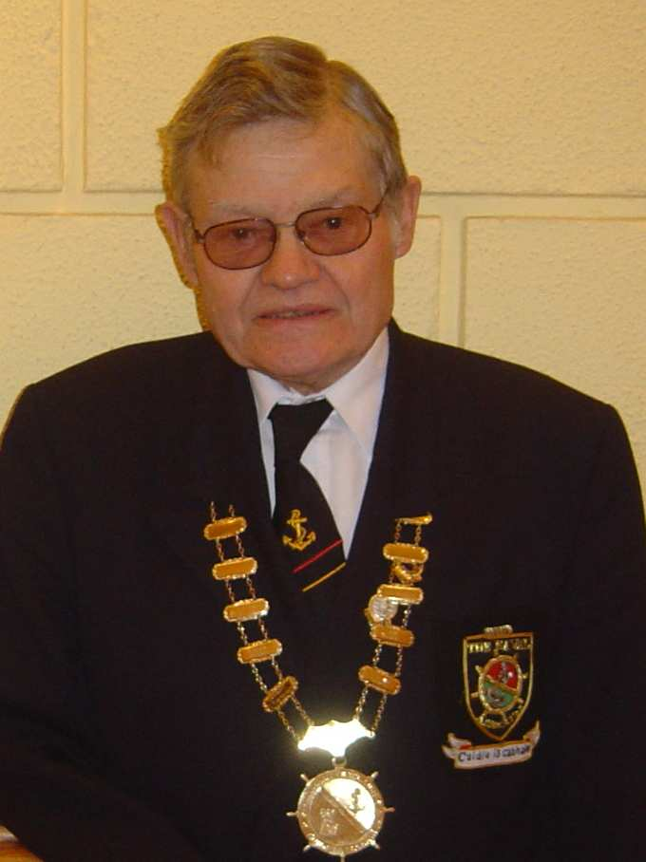
Michael Burke (President 2002)
Lt. Cmdr. Michael Burke Joined the Irish Naval Reserve in 1949 and rose through the ranks to Lt. Commander. Michael took over as Officer Commanding the Naval Reserve in Waterford in 1964 and retired as commanding officer in 1988.
Michael born in 1931 had 4 brothers and 3 sisters. Michael had a life long interest in Flower Class Corvettes perhaps due to some of his training on the Irish Flower Class Corvettes in service from 1946 to 1972. Michael was a member of the Flower Class Corvette Association and was Irish delegate to the Flower Class Corvette Association.
Michael was a founder member of the Waterford Branch of the Irish Naval Association and was elected its first chairman in 1993.
Michael Burke did not enjoy good health in the years prior to his death .

Slide 25
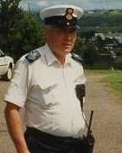
SCPO Seamus Dalton
Senior Chief Petty Officer Seamus Dalton will be remembered as an excellent NCO and every rank above and below Seamus respected him for his training abilities.
He epitomised the real life senior NCO who got things done and no one questioned Seamus, they just got on with the task Seamus had given them . A great Seaman and very well liked by all who came in contact with him. Seamus died of that dreaded disease “Alzheimer's” At a relatively young age

Slide 26
SCPO Noel O’Neill a gentle giant was also a very respect NCO who spent 41 years in An Slua Muiri (Naval Reserve) . On retiring from the Service on age grounds Noel joined the Naval Association and enjoyed many overseas trips with his colleagues in the Limerick Branch and friends and colleagues in the Dublin, Waterford and Cork Branches. Noels health declined over a period of years and Noel sadly passed away in 2011. Noel is sadly missed by us all

Slide 27
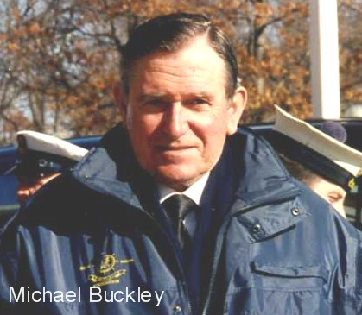
served in the communications branch of the Naval Service in the 60' 70's. Michael joined the Naval Association when the Association was revamped in 1992 and served as Treasurer. Michael was very active and participated in many trips abroad including the Boston St. Patrick's Day Parade and trips to the WW1 battle sites.

Slide 28
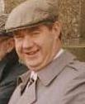
P/O Paddy Dunphy was a member of the Waterford Branch of An Slua Muiri. Following his retirement from An Slua Muiri Paddy joined the Naval Association. It is sad to recall that Paddy’s two brothers died suddenly of Heart Attacks at a relatively young age, and little did we know, Paddy would follow shortly also from a Heart attack. The three brothers are buried side by side in Waterford Cemetery and you cannot help but notice on the Headstone they died almost a year apart and almost to the day and you cannot help but remember similar graves in the Battle fields of Belgium and France holding many young Brothers who went with the Pals Brigades to fight in the Great War

Slide 29
Dick Larkin SCPO Larkin joined the Maritime Inscription in 1943 which subsequently was renamed An Slua Muiri in 1947 and rose through the ranks to Senior Chief Petty Officer and retired on reaching the retirement age for his rank in 1986. Dick as he was known to his friends will always be remembered for his catch phrase "Hello There". Dick was to travel to Boston in 1996 with the Naval Association to participate in the Boston St. Patrick's Day Parade celebrating the 50th anniversary of the establishment of the Naval Service in 1946 (formerly The Marine Service). However Dick got sick some weeks before we were to travel and passed away on Wednesday 13th March 1996 two days short of his 70th Birthday. Many will remember the Mass celebrated by the US Military Chaplain at Fort Deven's on Friday 15th (the Day Dick was buried)at the close of his sermon the Chaplain referring to Dick said, I some how believe at this very moment Dick is arriving in Heaven and saying to God "Hello There"

Slide 30
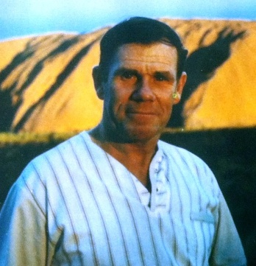
Liam Clarke a serving member of the Naval Service when he passed away in 2008 was serving on the Cadre Staff at Cathal Brugha Barracks in Dublin. One lasting memory of Liam is his delight as he skied down the Mountain in Boston when the Naval Association when on a skiing trip in 1998.

Slide 31
Also to be remembered and hopefully photo's details will be added when they are at hand.

Slide 32
Patrick Butler
Pat served in the Naval Service in 50's and later joined the Naval Association when the Association was revamped in 1992 and participated in many trips abroad including the Boston St. Patrick's Day Parade and trips to the WW1 Battle sites.

Slide 33
Peter Fitzpatrick
Peter served in the Marine Service from 1943 and the Naval
Service when re-named in 1946 and left the service in the mid 50's.
Peter joined the Naval Association in 1992

Slide 34
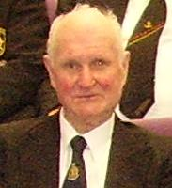
Basil Switzer R.I.P.
Spent many years in the Marine Service and the Naval Service.
Basil was a member of Naval Association up to his death in 2012

Slide 35
John Walsh R.I.P.
John was a member of the Naval Association during it’s earlier years and when The Naval Association was re-vamped in 1992 became our General Secretary from 1992 to 1994.
John passed away some years ago but we will
get as much information on our colleagues as time goes on
and add it to each slide.
Yes we will remember them

