Slide 1
Pictures from our Cruises To start Slide show click Slide Show at top of page then click on “from Beginning” at top left hand side

Slide 2
Saint Marks Square in Venice

Slide 5
Sit down and enjoy the music and then see your bill charges

Slide 7
Church of St. Germain, Venice,with the remains of Saint Lucia

Slide 9
Kay Watts, Eileen Walsh and May Kirwin, enjoy the the trip

Slide 13
Just ahead the famous Rialto Bridge

Slide 14
Frank Lane and Dick Flynn and families enjoy the dinner

Slide 15
Sean Meleady (left) had serious Cancer Surgery but still came on the Cruise, his wife Mona , Con & Betty Donovan

Slide 16
Liam and Brenda Lyons (front), Terry McGowan and John Hannon and six of the King Family

Slide 17
Our Waterford Colleagues

Slide 18
Our Waterford Colleagues including (left) Mary O’Halloran Mayor of Waterford

Slide 20
Terry Cummins (front) with two Italian Friends

Slide 22
Herbert McManus with Son, Daughter-in-Law and Grandson

Slide 23
Pat O’Raw, Bernie McGuirk, Anne Long, Danny O’Raw, Pat McGuirk and George Long

Slide 24
Saint Marks Square (Venice)

Slide 25
Our Cruise Ship Splendour of the Seas

Slide 32
Church of Saint Germain with the remains of Saint Lucia

Slide 33
Betty Donovan, Mona Meleady, Rita Murray and Margaret Cummins (Croatia)

Slide 34
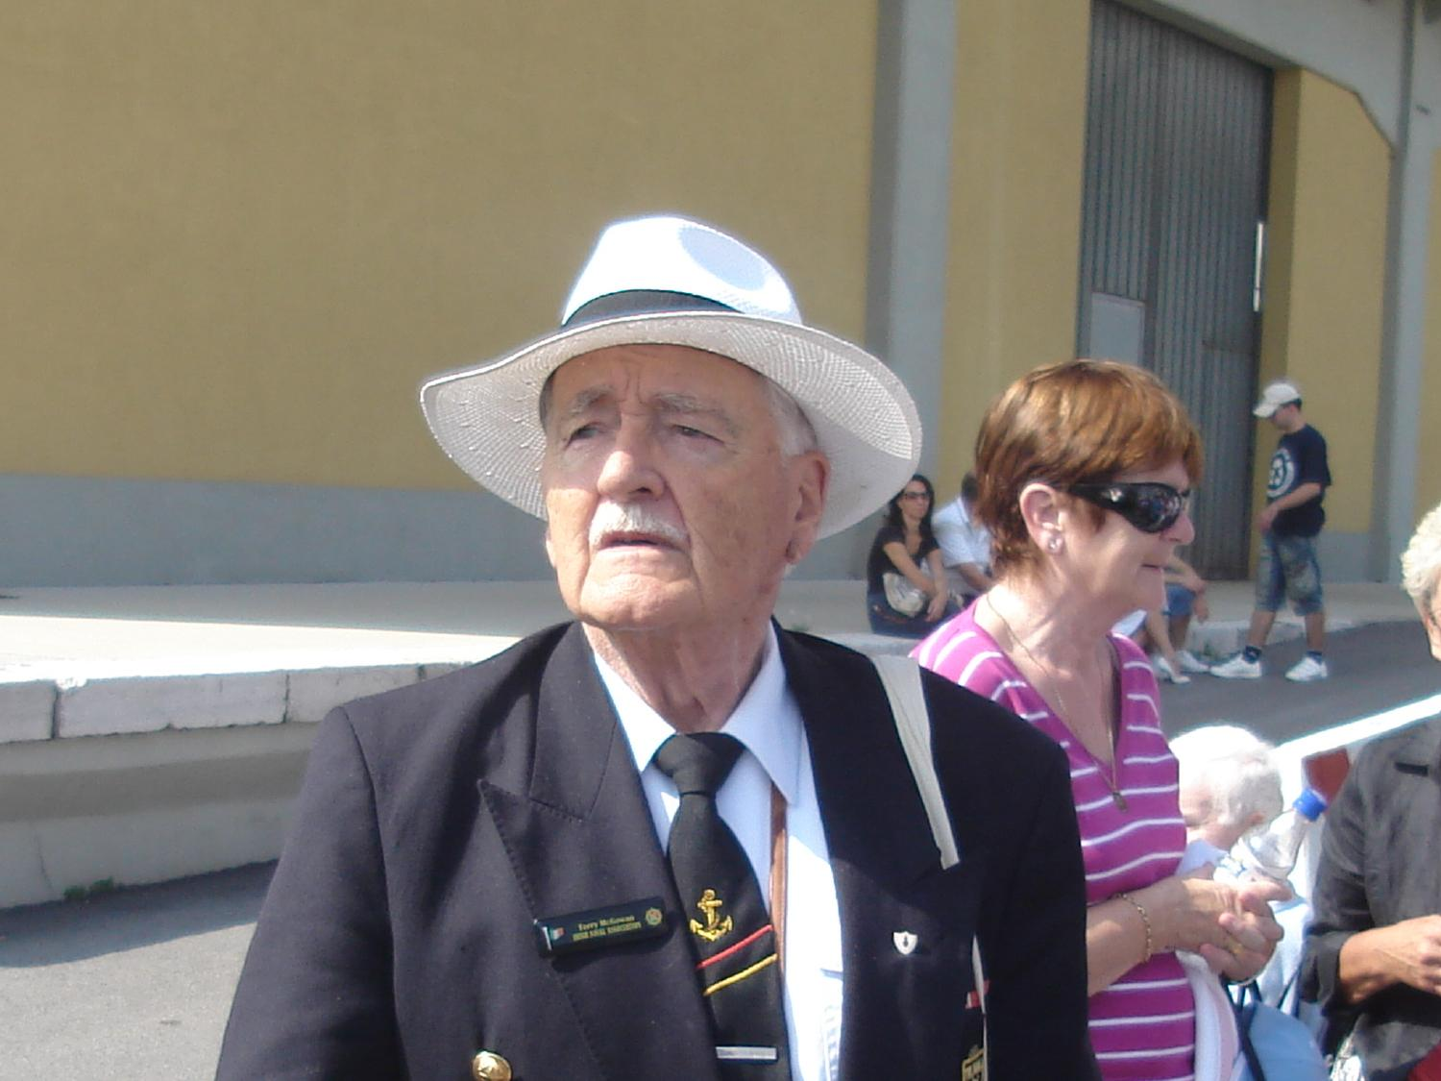
Terry McGowan at 88 years of age show how to dress for the occassion

Slide 35
Terry Cummins with Sean Meleady. Sean had serious Cancer Surgery but, still wanted to come on his first Cruise

Slide 36
Croatia

Slide 40
Frank Lane and Wife with their Son Vincent

Slide 43
Patsy King (2nd left) with her two sisters Anne and Babs and Brother-in-law Peter

Slide 44
Terry McGowan (left) and John Hannon

Slide 46
Con and Betty Donovan ready for the Captains Dinner

Slide 50
Liam Lyons

Slide 52
Herbert McManus and Terry Cummins

